Slide 1
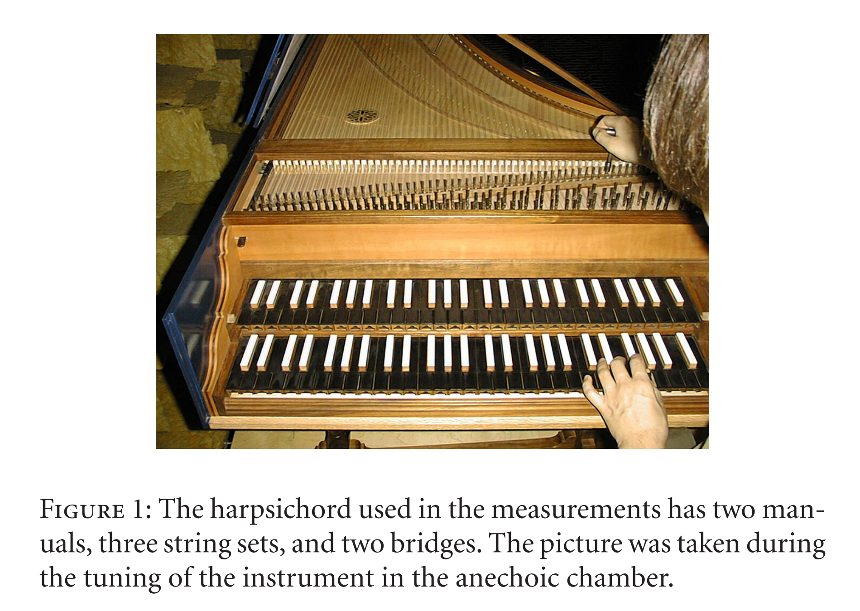
Precomputed Harpsichord Synthesis using a Physically-Inspired Signal Processing Framework after Valimaki et al. [2004]
Zane Wang, Cheriton School of Computer Science
Computer Graphics Lab

Slide 2
Background
The harpsichord is a keyed string instrument dating back to the early Renaissance
Frequently featured in Baroque music:
as a solo instrument (J.S. Bach, Domenico Scarlatti, etc.)
as a part of the Basso Continuo group in a chamber setting
or as an accompanying instrument to another solo musician
More modern examples:
OST from Baldur’s Gate III, Dark Souls, Genshin Impact, and many others all feature the harpsichord
Associated with medieval fantasy, gothic settings
The harpsichord is played by depressing the keys, which lifts a plectrum to pluck the strings

Slide 3
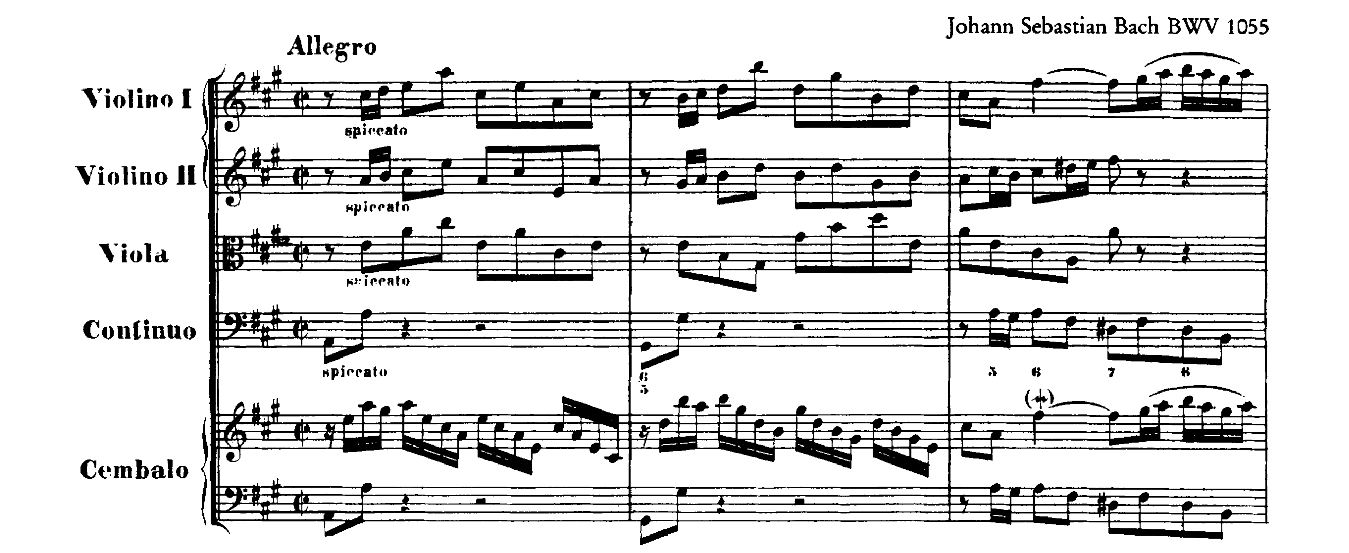
Background

Slide 4
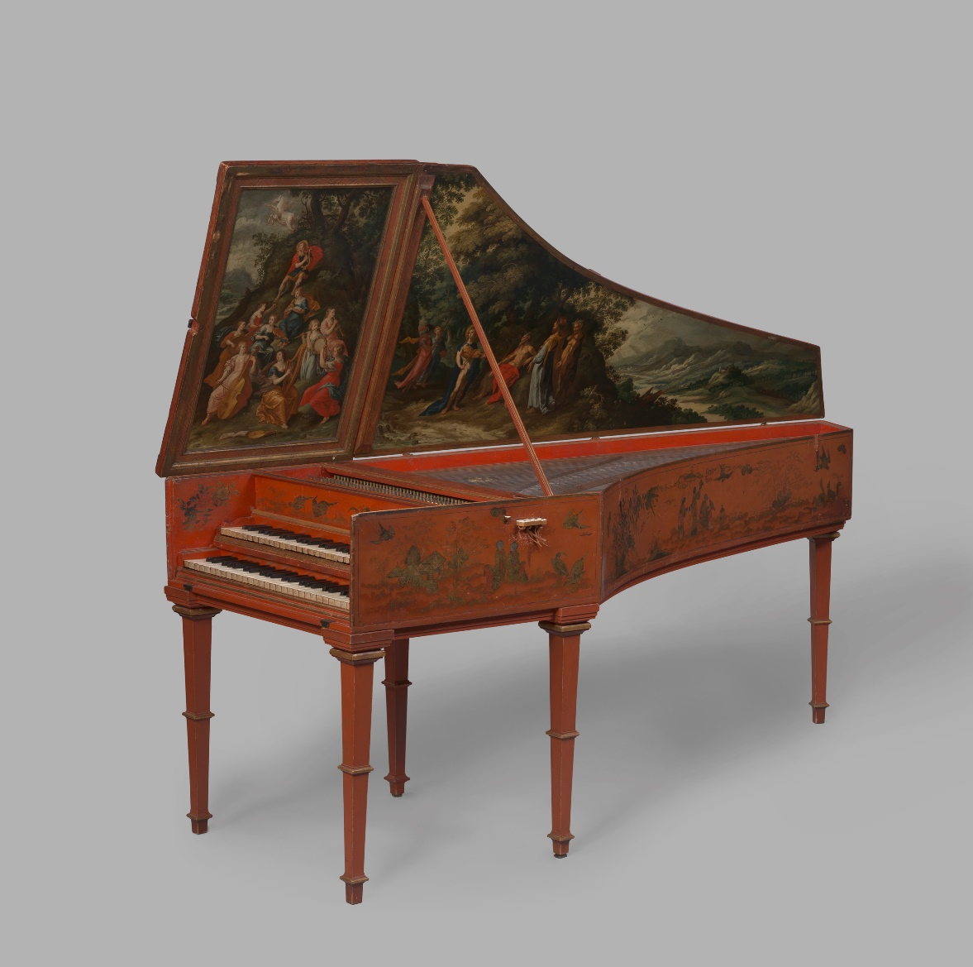
Motivation
We know that the sonic possibilities with digital audio synthesis are endless
For this project, I choose to focus on historical instrument synthesis
Harpsichords are:
Rare
Expensive
Fragile
High-maintenance
Hard to transport
But their sound is still crucial in modern music performance!

Slide 5
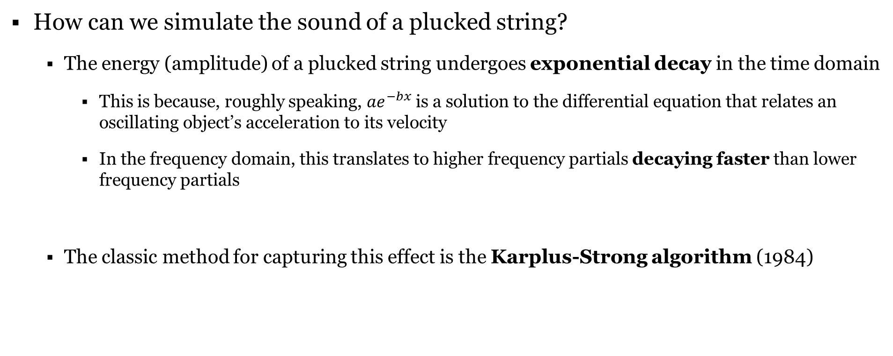
Background – Plucked String Synthesis
How can we simulate the sound of a plucked string?
The energy (amplitude) of a plucked string undergoes exponential decay in the time domain
This is because, roughly speaking, ${ae}^{−bx}$ is a solution to the differential equation that relates an oscillating object’s acceleration to its velocity
In the frequency domain, this translates to higher frequency partials decaying faster than lower frequency partials
The classic method for capturing this effect is the Karplus-Strong algorithm (1984)

Slide 6
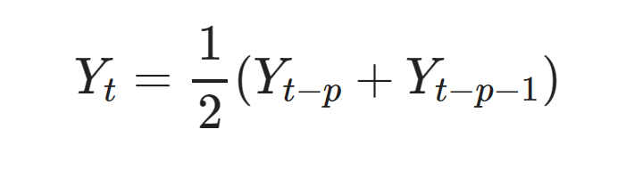
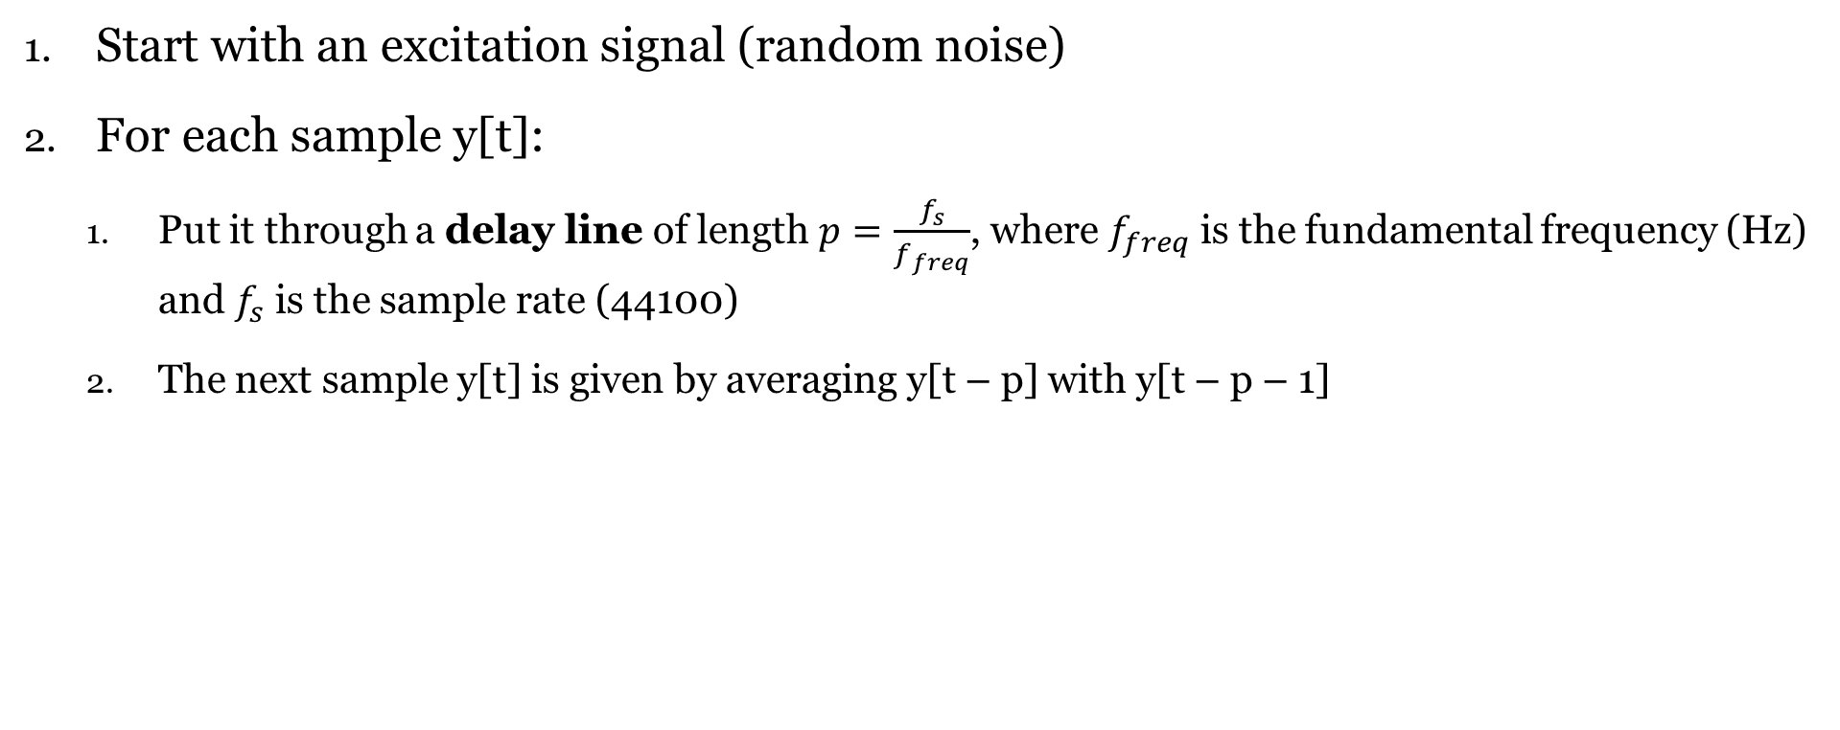
Karplus-Strong Algorithm
Start with an excitation signal (random noise)
For each sample y[t]:
Put it through a delay line of length $p=\frac{f_{s}}{f_{freq}}$, where $f_{freq}$ is the fundamental frequency (Hz) and $f_{s}$ is the sample rate (44100)
The next sample y[t] is given by averaging y[t – p] with y[t – p – 1]

Slide 7
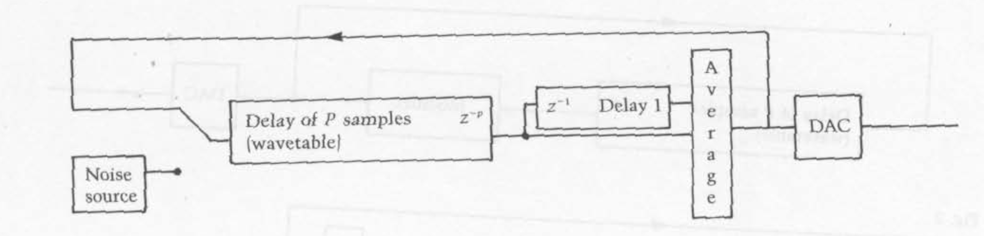
Karplus-Strong Algorithm

Slide 8
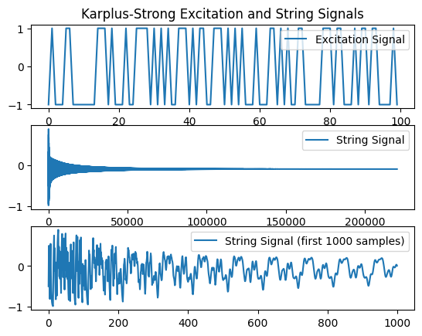
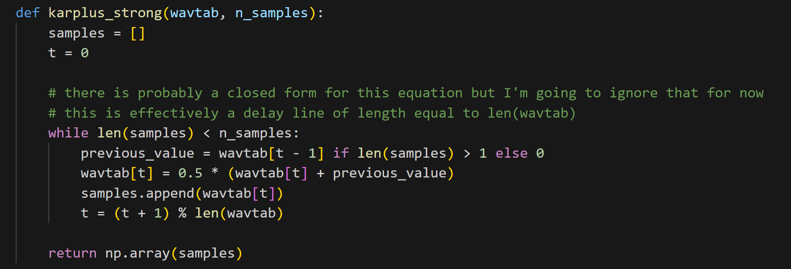
Karplus-Strong Algorithm

Slide 9
Karplus-Strong Algorithm
Limitations
Doesn’t sound real
If anything, it sounds more like a guitar than a harpsichord
The harpsichord’s frequency profile is more complex than what we get from Karplus-Strong synthesis
In its original form, there aren’t enough parameters to modify the sound
A noise burst is not a physically correct excitation signal

Slide 10
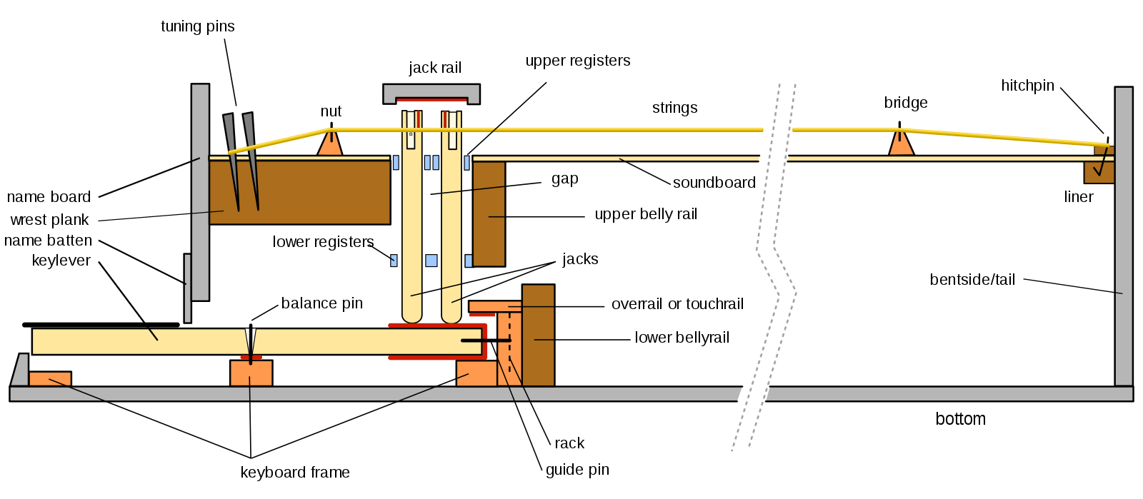
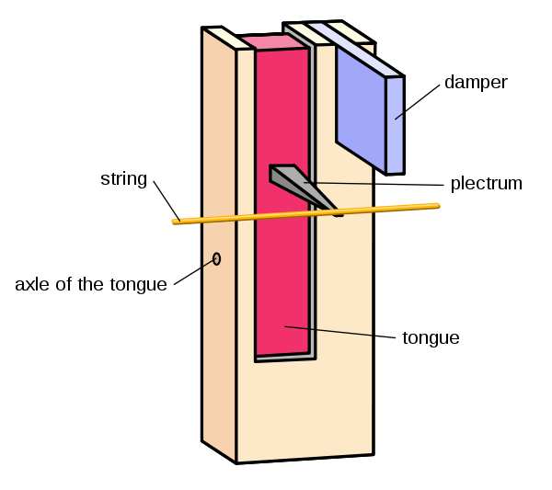
Valimaki et al. - Overview
Synthesize harpsichord sounds using a physical model fit to measured data
Include acoustic effects that arise from the instrument’s anatomy

Slide 11
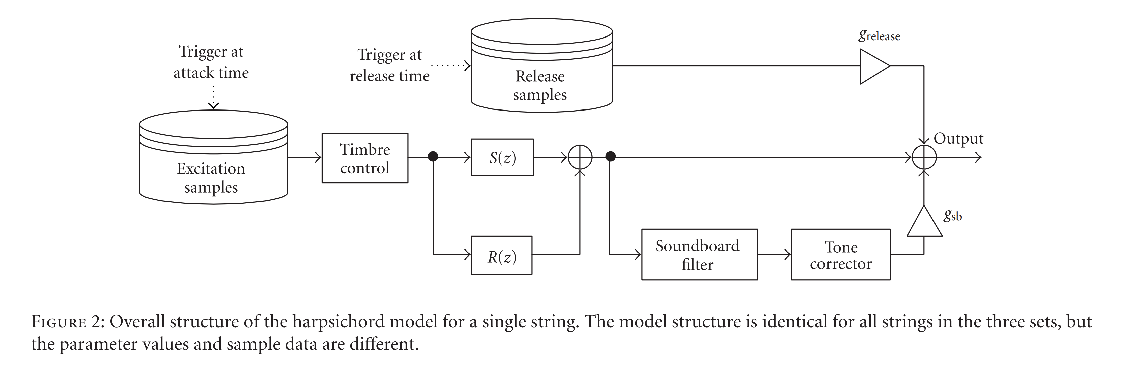
Schematic of Harpsichord Model

Slide 12
Excitation Signal
The excitation signal input is acquired from a real harpsichord
Extracted from a recording of a plectrum hitting one of the strings
This signal should contain all the energy that is input to the system
Physical model: simulate energy transfer & string oscillation with delay lines and other filters

Slide 13
String Filter
Arguably the most important part of the model
At its core, it is a feedback delay line just like with Karplus-Strong
Key differences:
A one-pole filter strengthens low-pass characteristics
Stronger attack & faster decay
A ripple (feedforward comb) filter selectively suppresses certain harmonics
Allows for a very close fit to measured data
An allpass filter accounts for dispersion (phase incoherence of partials)
Caused by string stiffness

Slide 14
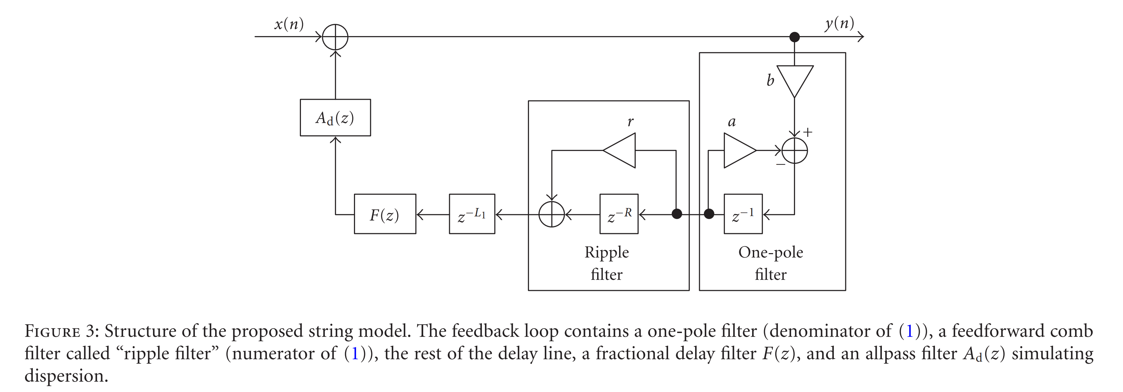
String Filter – Block Diagram

Slide 15
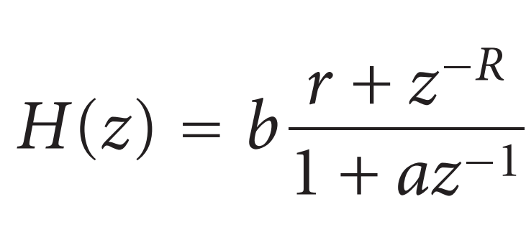
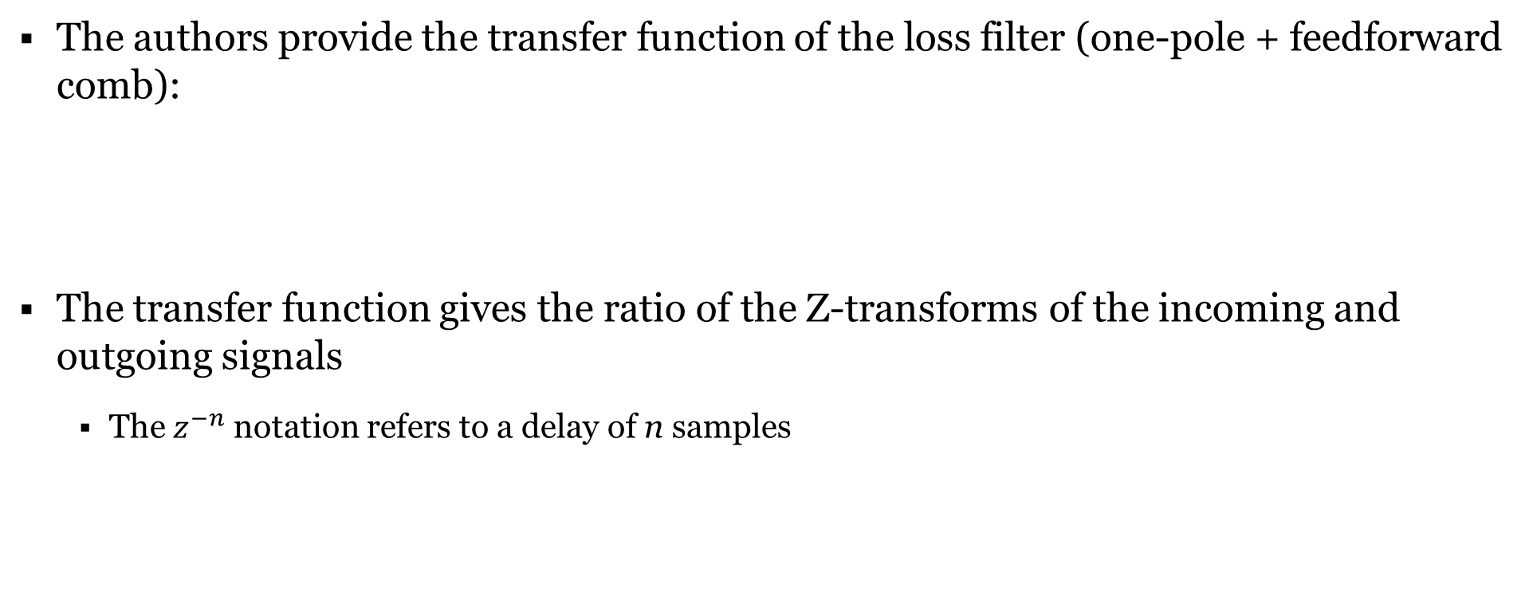
String Filter – Signal Processing Derivations
The authors provide the transfer function of the loss filter (one-pole + feedforward comb):
The transfer function gives the ratio of the Z-transforms of the incoming and outgoing signals
The $z^{−n}$ notation refers to a delay of n samples

Slide 16
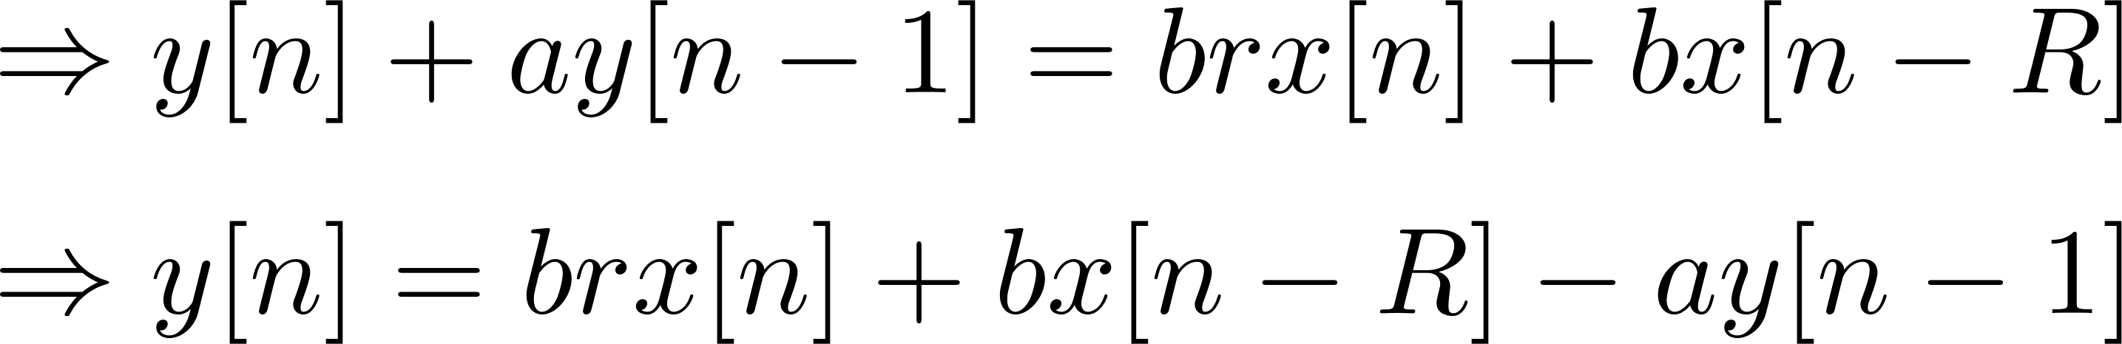
String Filter – Signal Processing Derivations
The transfer function gives the ratio of the z-transforms of the incoming and outgoing signals
Inverse z-transform gives us the difference equation:
Where y[n] and x[n] are the nth samples in the output and input, respectively

Slide 17
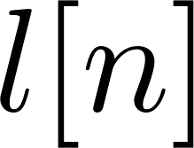
String Filter – Signal Processing Derivations
That gives us the output of the loss filter:

Slide 18
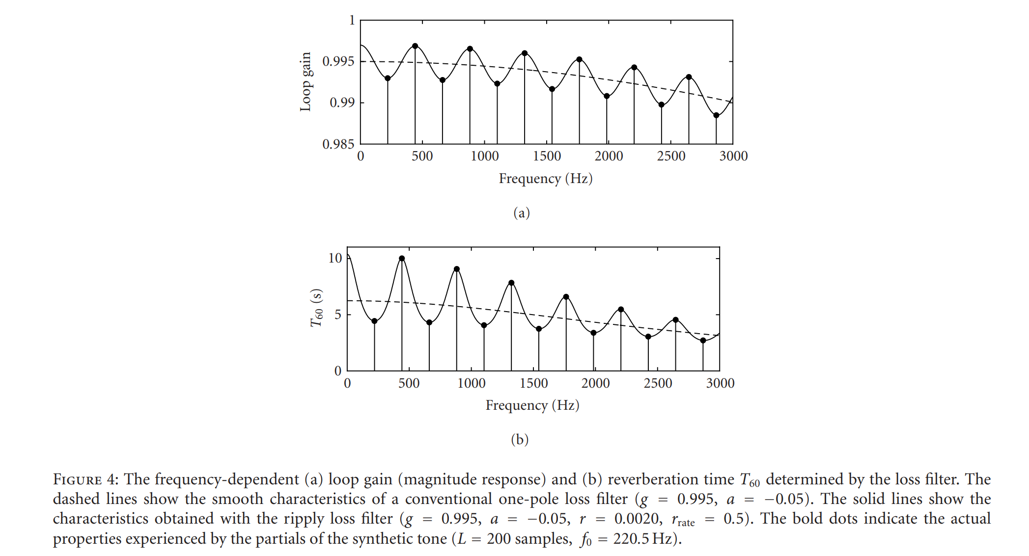
Effect of Loss Filter

Slide 19
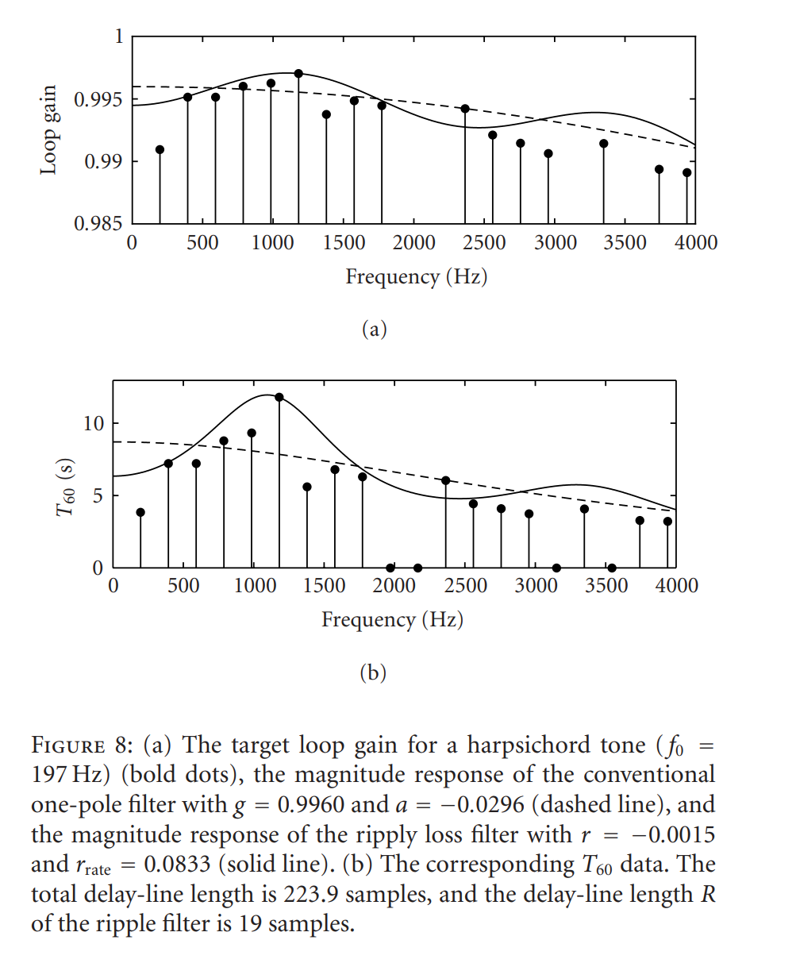
Effect of Loss Filter

Slide 20
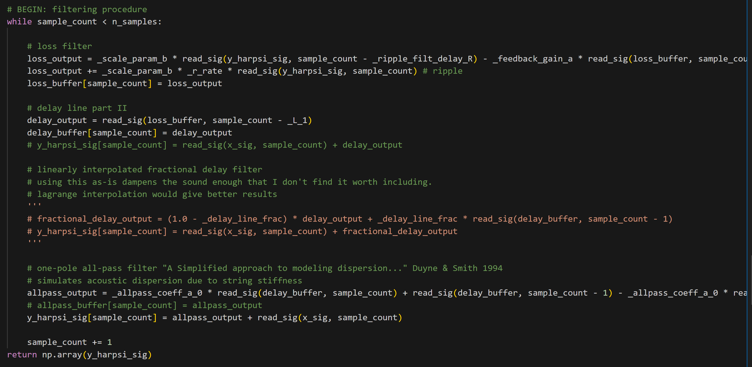
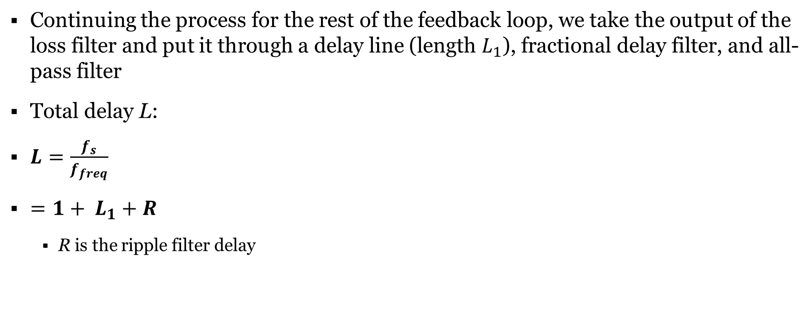
String Filter – Signal Processing Derivations
Continuing the process for the rest of the feedback loop, we take the output of the loss filter and put it through a delay line (length $L_{1}$), fractional delay filter, and all-pass filter
Total delay L:
$L=\frac{f_{s}}{f_{freq}}$
$=1+ L_{1}+R$
R is the ripple filter delay

Slide 21
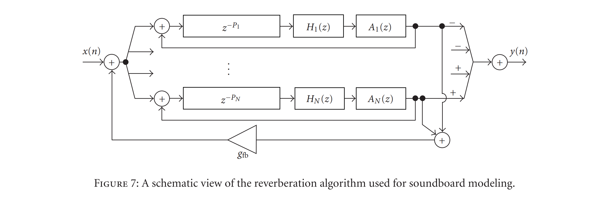
Soundbox Reverb
Implemented with a modified FDN
reverb algorithm
Cascaded delay lines combined with loss filters simulate the “echo-y” effects of a very small room (which is what the soundboard effectively is)

Slide 22
Key Release
The key release samples were recorded from a real harpsichord
Simply trigger the release when the note ends/the key on the controller is lifted

Slide 23
Our Implementation
Precompute the string response by generating and writing the signal data one point at a time
Implemented in python (shamefully enough)
Save harpsichord samples as wav files
Excitation and release signals were taken from the authors’ website
Currently, soundbox reverb is approximated using the reverb effect in a commercial DAW
Build a SF2 standard soundfont in Polyphone for MIDI control
Their method was already real time in 2004, but:
My method promises better portability – can be used by anyone with a midi controller or notation software

Slide 24
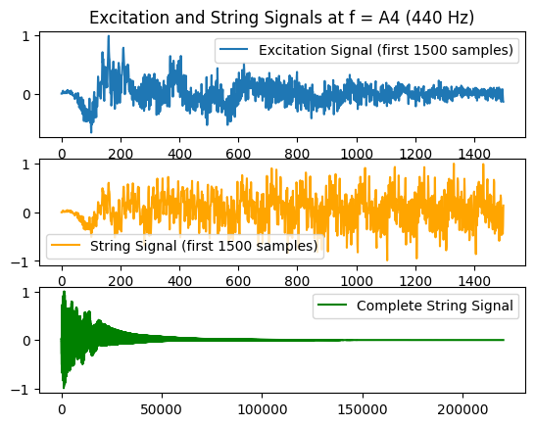
Our Implementation – String Model Results

Slide 25
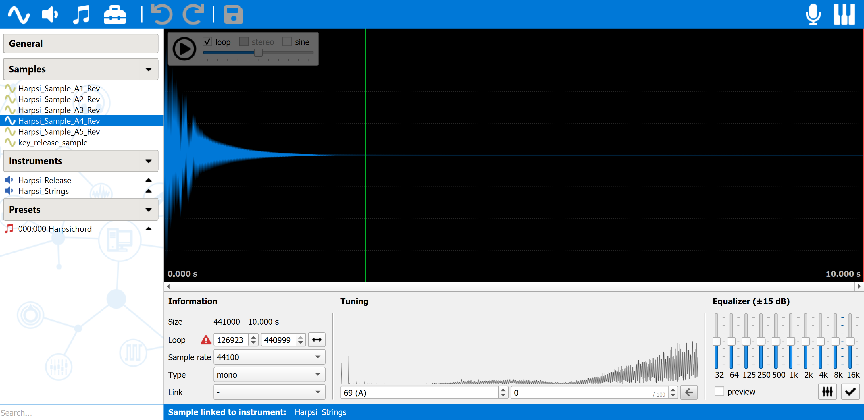
Polyphone – Sample Preparation

Slide 26
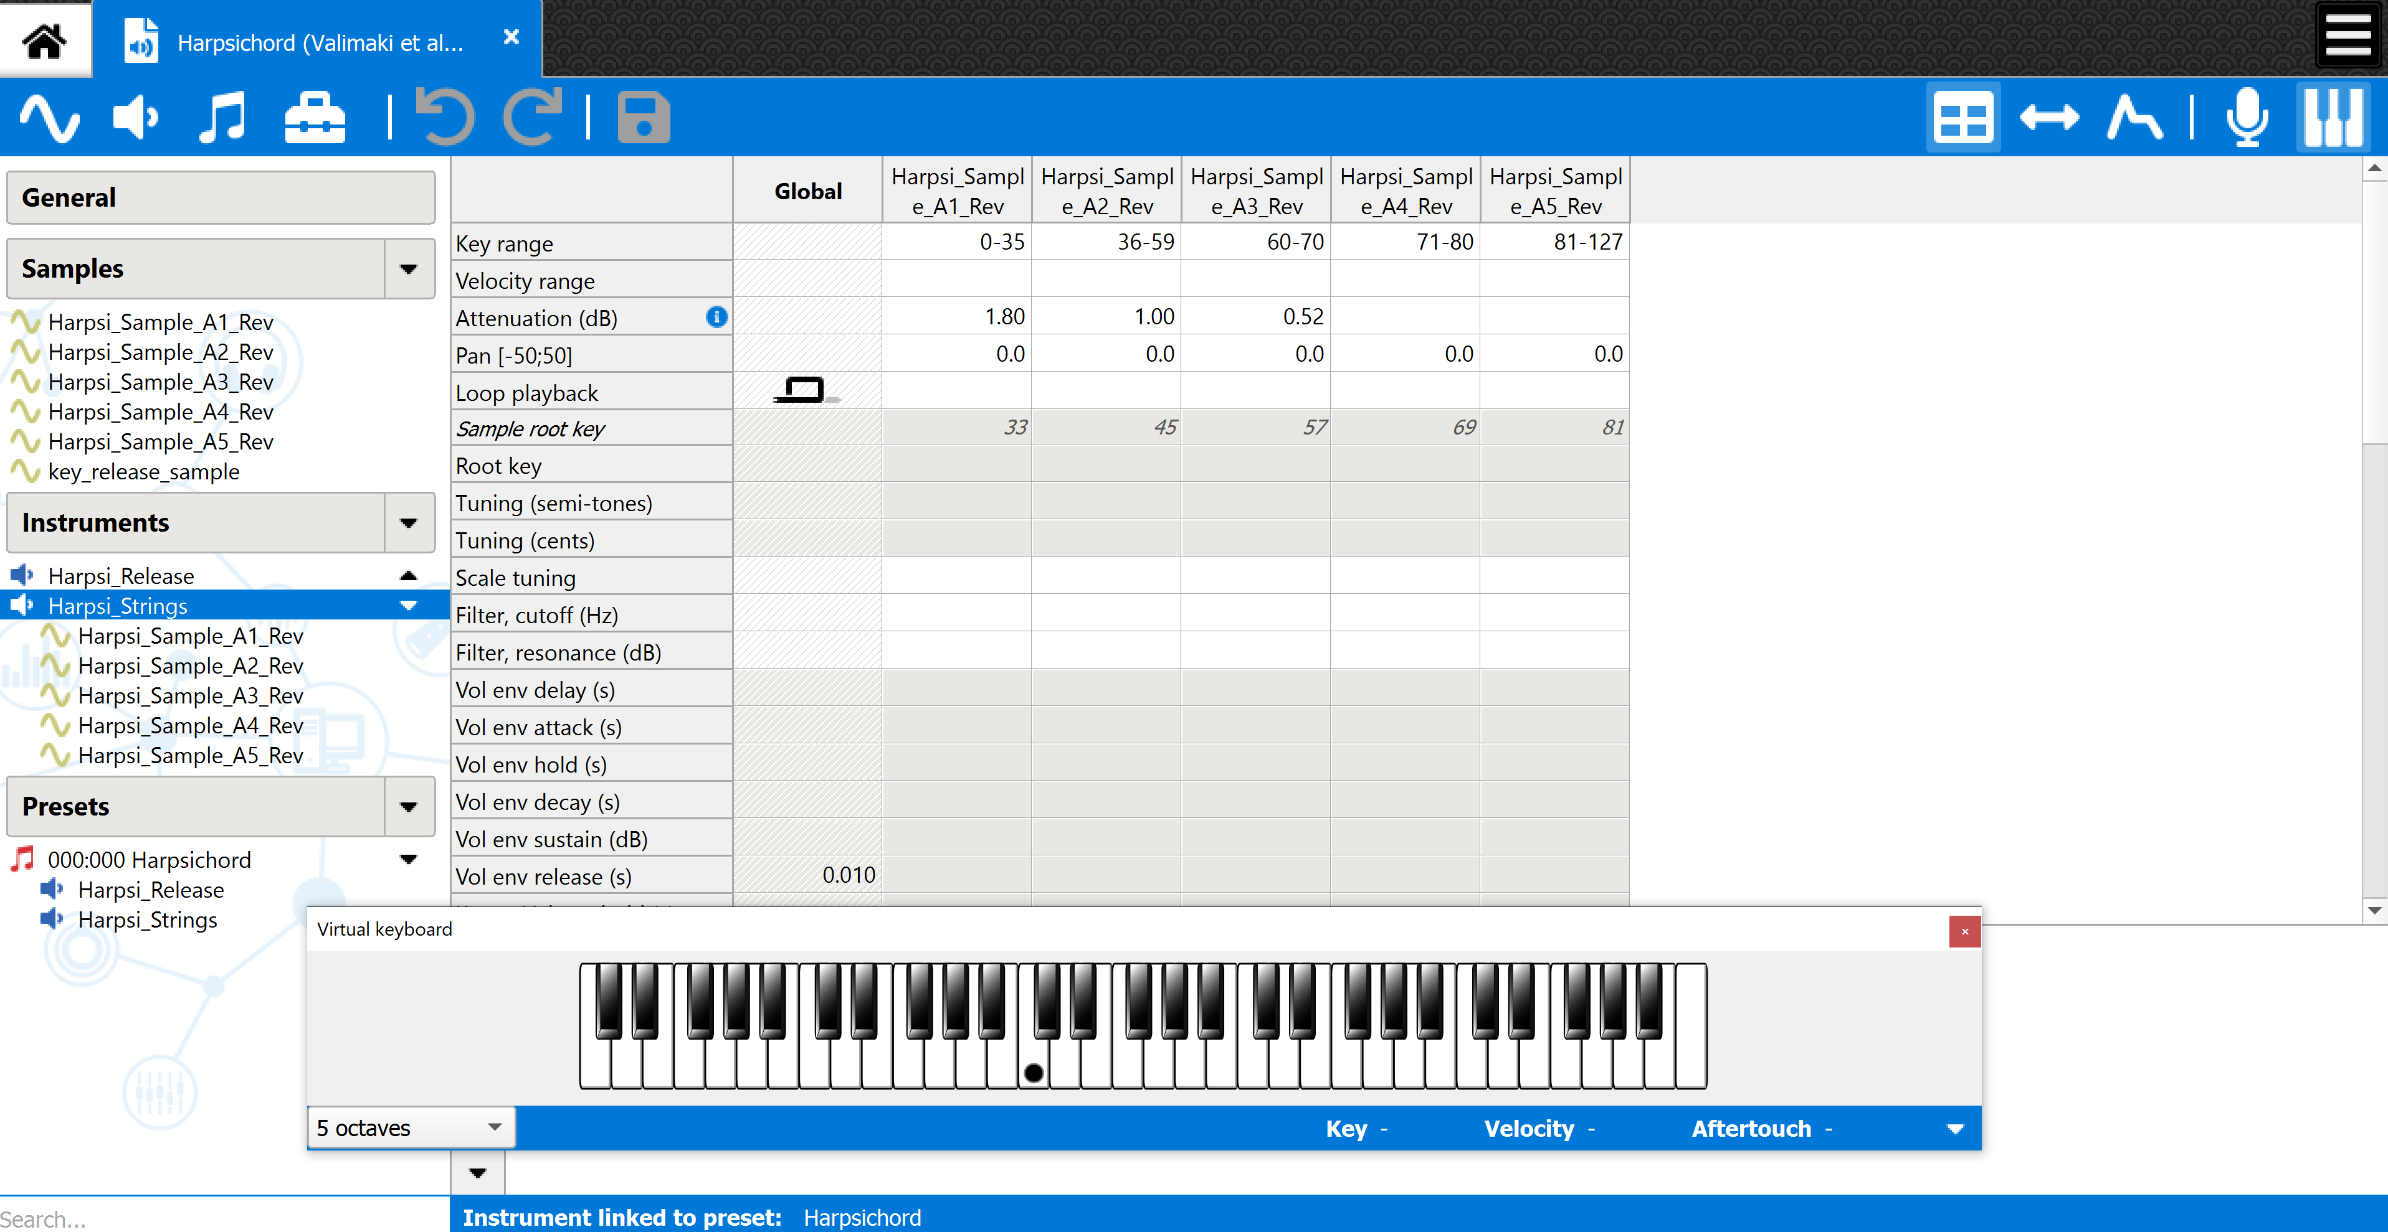
Polyphone – Soundfont Editing

Slide 27
Demonstration & Q&A

